Slide 1


SAP UI5 & FIORI with OData TRAINING
Anubhav Oberoy & Shekhar Vedi
Day – 13

Slide 2

Agenda – Day 13
Odata Integration with UI
Understanding the configuration of ui5.yaml
ui5.yaml and ui5-local.yaml for VS Code
Implementing Read in UI
Implementing Create in the UI
Implementing Upadte in UI
Implementing Delete uisng UI
Calling Function Import form the UI
Introduction to GitHub
Creating a Git Repository in GitHub.

Slide 3
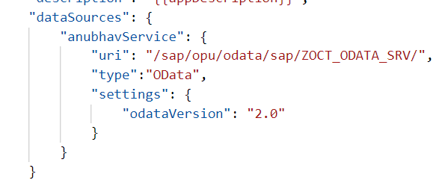
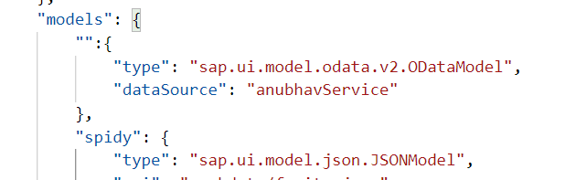
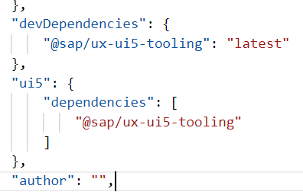
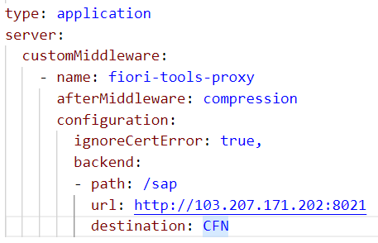
Integration of OData in our Fiori Project
Steps to Integrate our Fiori app with the OData service we have created.
Step 1: Go to manifest.json and define a data source in sap.app section.
Step 2: Go to sap.ui5 section and create a default data model for this data source
TO AVOID CORS issue in BAS tool so we can connect to our SAP SERVER
Step 3: Add a dev-dependency in package.json file to latest UI5 tooling - @sap/ux-ui5-tooling
Step 4: Also add a section called UI5 in package.json to use the tooling for the project.
Step 5: We will cheat the browser by adding a proxy module, this proxy module will re-direct all the calls starring /sap top our SAP Server via destination. In ui5.yaml file provide middleware configuration
Step 6: Test app using ui5 serve or fiori run command
Step 7: Binding with ODATA entityset

Slide 4
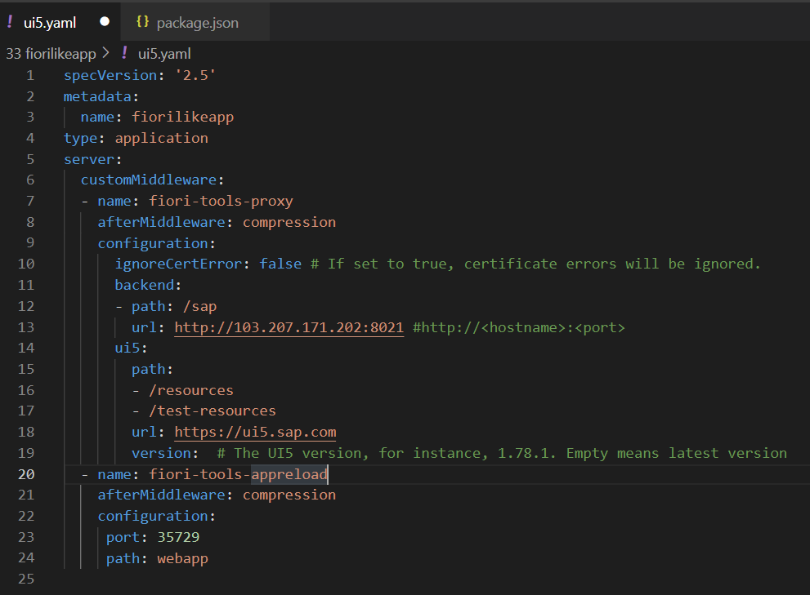
Configuring ui5.yaml for VS Code
To use the OData service in VS Code we must configure the ui5.yaml file according to that. We need to configure it according to the below format.
specVersion: '2.5'
metadata:
name: fiorilikeapp
type: application
server:
customMiddleware:
- name: fiori-tools-proxy
afterMiddleware: compression
configuration:
ignoreCertError: false
backend:
- path: /sap
url: http://<hostname>:<port>
ui5:
path:
- /resources
- /test-resources
url: https://ui5.sap.com
version:
- name: fiori-tools-appreload
afterMiddleware: compression
configuration:
port: 35729
path: webapp

Slide 5
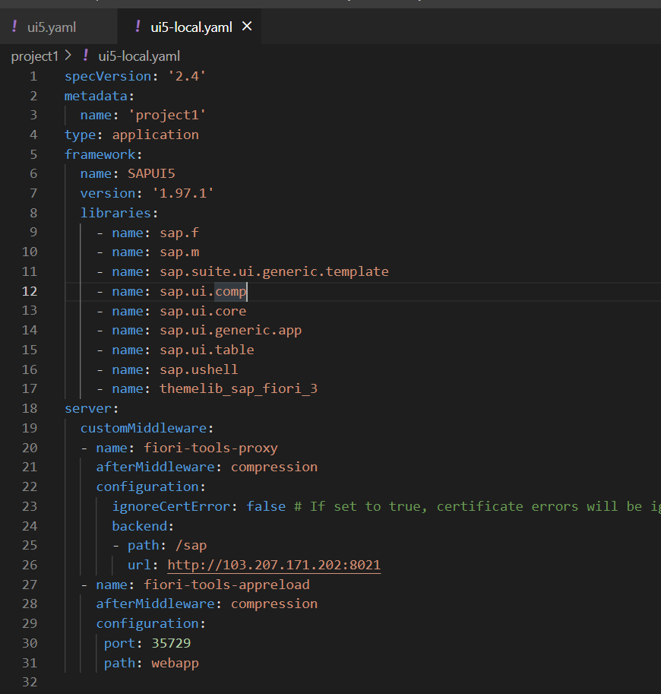
ui5-local.yaml configuration
To run and access the OData service in application in a local environment we also need a ui5-local.yaml file. The structure of ui5-local.yaml file is shown below:
specVersion: '2.4'
metadata:
name: 'project1'
type: application
framework:
name: SAPUI5
version: '1.97.1'
libraries:
- name: sap.f
- name: sap.m
- name: sap.suite.ui.generic.template
- name: sap.ui.comp
- name: sap.ui.core
- name: sap.ui.generic.app
- name: sap.ui.table
- name: sap.ushell
- name: themelib_sap_fiori_3
server:
customMiddleware:
- name: fiori-tools-proxy
afterMiddleware: compression
configuration:
ignoreCertError: false # If set to true, certificate errors will be ignored. E.g. self-signed certificates will be accepted
backend:
- path: /sap
url: http://103.207.171.202:8021
- name: fiori-tools-appreload
afterMiddleware: compression
configuration:
port: 35729
path: webapp

Slide 6

Exercise
In this exercise we will add the configuration to Integrate the OData with our existing app.
And we will bind the View1 with the OData model.
Along with that we will also see how to read the data of a single product.
To do that when we select a product form the product list then the details of that product will be loaded on the View2.
Exercise part 1 code/resource: Configuring the app to access OData and loading the list of products on view1
manifest.json
ui5.yaml
package.json
View1.view.xml
ui5.yaml and ui5-local.yaml config for VS Code
ui5.yaml
ui5-local.yaml
Exercise part 2 code/resource: Getting the data of single product with association To_Supplier on View2.
View1.view.xml
View1.controller.js
View2.view.xml
View2.controller.js
MoreInfo.fragment.xml

Slide 7
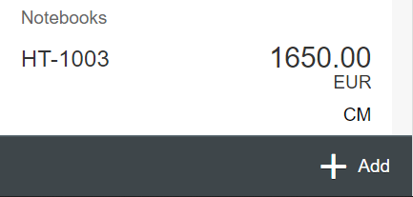
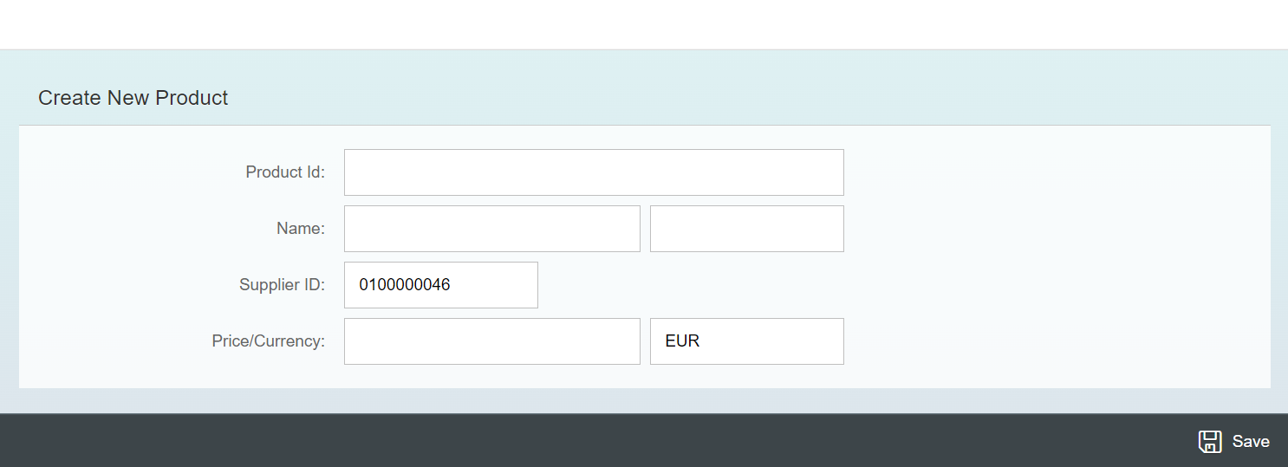
Exercise - Implement Create using UI
Now we will implement create operation in the UI. To do that we need to add a new screen in our application. In that screen we will add a simple form to fill the details of the product and a Save button in the footer of that page.
For this have to a new Add button in the footer of the View1 and on press of that button we will navigate to the new Add View.
Exercise code/resource:
View1.view.xml
View1.controller.js
Add.view.xml
Add.controller.js
manifest.json

Slide 8

Exercise – Implementing Update and Delete
Now we want to Update and Delete the selected record form the backend. To do that we will load the data of the record. Once the data is loaded to update and delete the data, we will add two buttons in the footer of the view named as Save and Delete. We will also add a clear button to clear the data of form.
On entering the Product ID of the product in the Input field and press enter we will load the data of that product in the Form.
Exercise code/resource:
Add.view.xml
Add.controller.js

Slide 9
Title
Content

Slide 10

End of Day 13

Slide 11

Questions

Slide 12

Anubhav Oberoy

Slide 13


We’re committed to empower you to be
Most Desirable Resource
through powerful training solutions.
We build the workforce of the future.
250+
Corporate Clients
30,000+
Learners Trained
25000+
Learners Placed
FREE WEBINARS
Sign up for free webinars with industry experts every fortnight!
Enroll Now!
Contact us today!
https://anubhavtrainings.com/

Slide 14




More from AnubhavTrainings.com

Slide 15
Title
Content

